Slide 1
COVID-19 Case Assessment

Slide 2
Agenda
Executive Summary
Why are we here?
Summary of Findings
Trend Analysis
Demographics
Current State - As of 3/31
Country/State Timelines
Summary of Credible Dashboards

Slide 3
Executive Summary : USA States
Demographics place +30% of our population in the “high risk” category for COVID-19.
Expected Peak Ranges by state/region:
Recovery data found at country level to-date.
State | Inception Date | Expected New Case Peak Date Range | Least Confirmed Case Date Range
Michigan | 3/11 | 4/5 - 4/12 | 4/21 - 4/28
Ohio | 3/10 | 4/4 - 4/11 | 4/20 - 4/27
Indiana | 3/10 | 4/4 - 4/11 | 4/20 - 4/27
Illinois | 3/5 | 4/1 - 4/8 | 4/18 - 4/25
Ontario | 3/2 | 3/29 - 4/5 | 4/15 - 4/22
New York | 3/2 | 3/29 - 4/5 | 4/15 - 4/22

Slide 4
Why are we here
As COVID-19 pandemic data continues to develop, Corporates have planned to bring production back on April 15th worldwide.
States are following the Wuhan example of “Sheltering in Place” by closing non-essential activities and business.
Using available data and analysis, can we better understand and predict when the pandemic may peak? Specifically for any particular region ( say Italy)

Slide 5
Summary of Findings - Timeline
CHN
Dec 31 : Case reported
Jan 11 : First death
Jan 23 Wuhan Shutdown
Feb 20: Shutdown
Feb 25: Highest cases
Mar 1 Cases flatten
Mar 22 Lifts restrictions
KOR
Jan 20 : First case reported
Jan 22 : First death
Feb 7: Test kits supplied
Feb 18: Total Shutdown
Feb 23: Drive thru test kits
Mar 2: Highest cases
Mar 28: Recovery higher than death
Jan 31 : Suspend Chn Flight
Feb 15 : First case reported
Feb 23 : 150+ cases
Mar 4: Schools closed
Mar 8: Non-biz Shutdown
Mar 22: Total Shutdown
Observations:
South Korea : Quickest response to shutdown on first case
Italy, USA :
Slow response to shutdown on first case
ITL
USA
Jan 21 : First case reported
Jan 31 : Suspend Chn Flight
Feb 29 : First death
Mar 13 : Shutdown
Mar 15 : Social Distancing
Dec
Jan
Feb
Mar

Slide 6
Summary of Findings - Demographics
Analysis of USA/Canada States
33% between ages 50 - 65
Ontario and Indiana are 46% and 47% respectively
4% over 65
Analysis of Mexico
10% between ages 50 - 65
0.02% over 65
50% of COVID-19 patients are ages 50+
Canada and Mexico have significantly fewer cases reported than US
Ontario, Canada: 1,700+
State of Mexico & Coahuila: 175+
Michigan: 6,000+

Slide 7
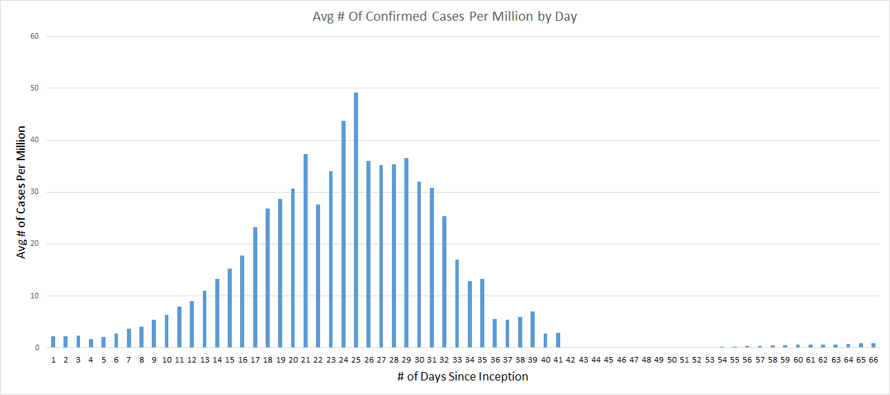
Findings - Global Avg Expected New Cases Per Day
State | Inception Date | Expected New Case Peak Date Range | Least Confirmed Case Date Range
Michigan | 3/11 | 4/5 - 4/12 | 4/21 - 4/28
Ohio | 3/10 | 4/4 - 4/11 | 4/20 - 4/27
Indiana | 3/10 | 4/4 - 4/11 | 4/20 - 4/27
Illinois | 3/5 | 4/1 - 4/8 | 4/18 - 4/25
Ontario | 3/2 | 3/29 - 4/5 | 4/15 - 4/22
New York | 3/2 | 3/29 - 4/5 | 4/15 - 4/22
As of Mar. 30
Source: John Hopkins Coronavirus Dashboard (link in notes).
Peak and Least dates depend on how closely each state follows global average
Definitions:
Inception Date - date John Hopkins begins recording case data
Expected Peak Date - date when the greatest number of new confirmed cases is reported
Least Confirmed Case Date - date when the least number of new confirmed cases is reported
Notes:
Source of data : John Hopkins https://github.com/CSSEGISandData/COVID-19/tree/master/csse_covid_19_data/csse_covid_19_time_series

Slide 8
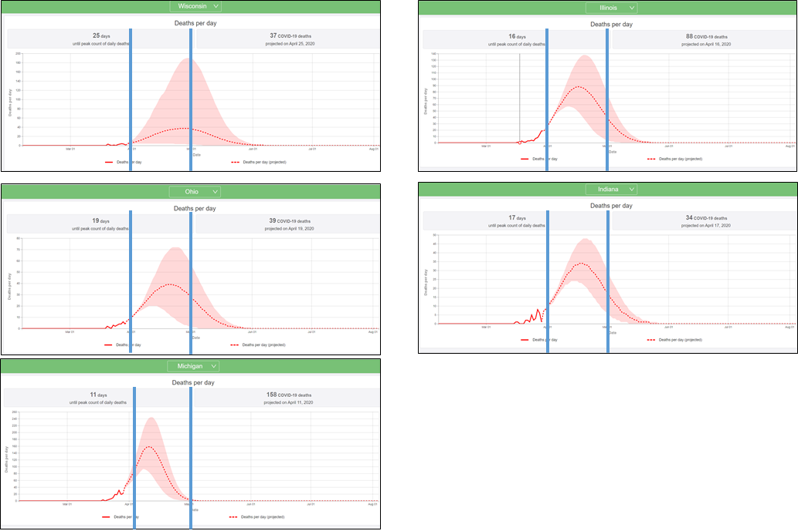
Findings - COVID 19 Daily Death Curve
Wisconsin
Illinois
IHME forecast model
Critical States | Death Peak | Minimal Cases
USA | 4/14 | 6/15
NY | 4/10 | 5/1
MI | 4/11 | 5/1
OH | 4/19 | 5/20
IN | 4/17 | 5/18
IL | 4/16 | 5/18
WI | 4/25 | 6/1
CA | 4/25 | 6/15
WA | 4/24 | 6/15
April 1
May 1
April 1
May 1
Ohio
Indiana
April 1
May 1
April 1
May 1
As of Mar. 30
Observations:
IHME model assumes social distancing thru May.
Michigan’s projected peak and curve is sooner and sharper than other midwest states.
Daily actuals following projections (2 days)
Michigan
April 1
May 1
Data source (link in Notes):
Institute for Health Metrics and Evaluation, University of Washington, COVID-19 Predictions
https://covid19.healthdata.org/projections
Notes:
Source Links:
https://covid19.healthdata.org/projections

Slide 9
Findings - Confirmed Cases, Fatalities & Recoveries
Country | Confirmed Cases | Fatalities | Recoveries
China | 82,278 | 3,309 | 76,206
South Korea | 9,786 | 162 | 5,408
Italy | 105,792 | 12,428 | 15,729
USA | 184,183 | 3,721 | 6,043
Canada | 8,484 | 96 | 1,554
Mexico | 1,094 | 28 | 35
Observations:
China and South Korea have the highest recovery rates at 93% and 55%, respectively
Italy recoveries recently became greater than fatalities
Canada’s recovery rate is high despite rising number of confirmed cases

Slide 10
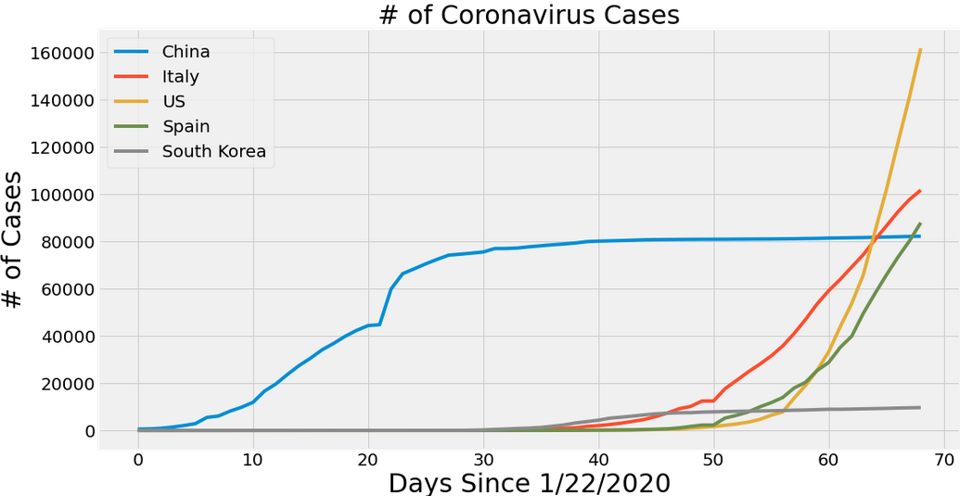
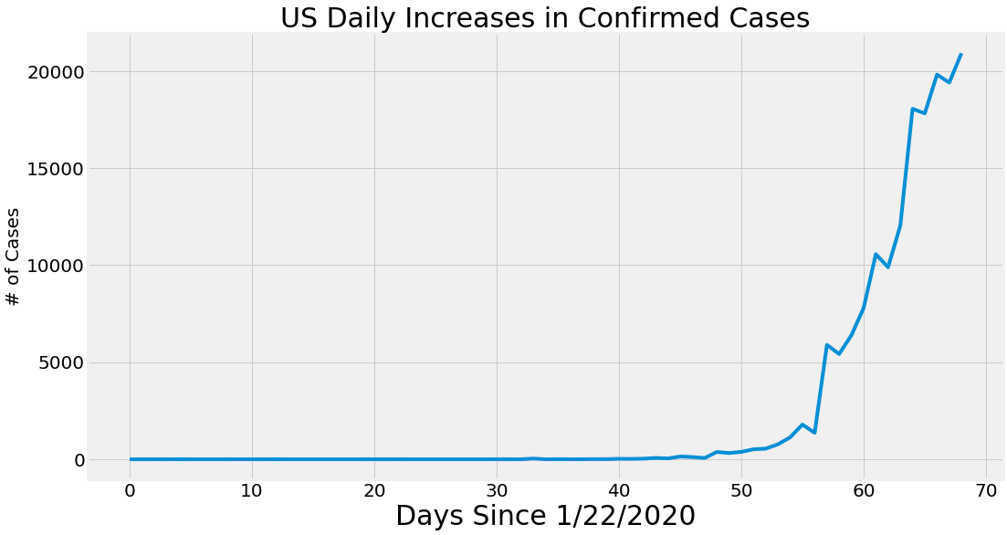
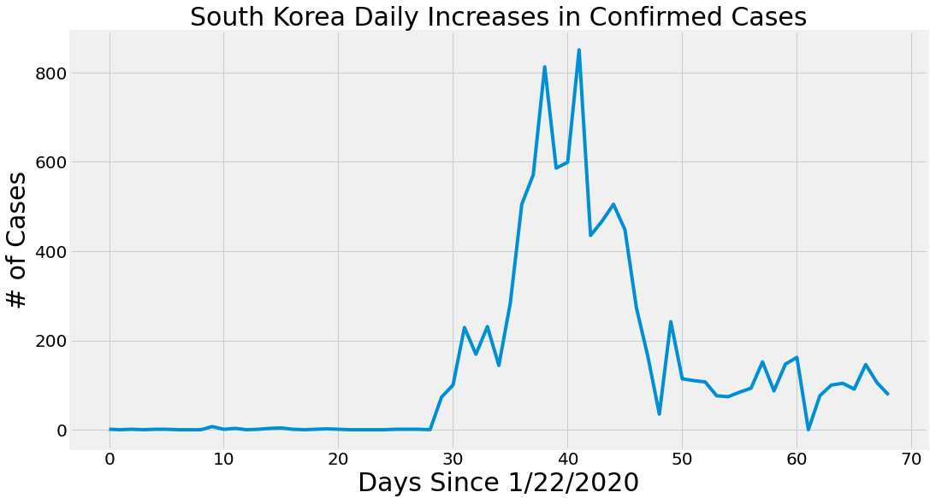
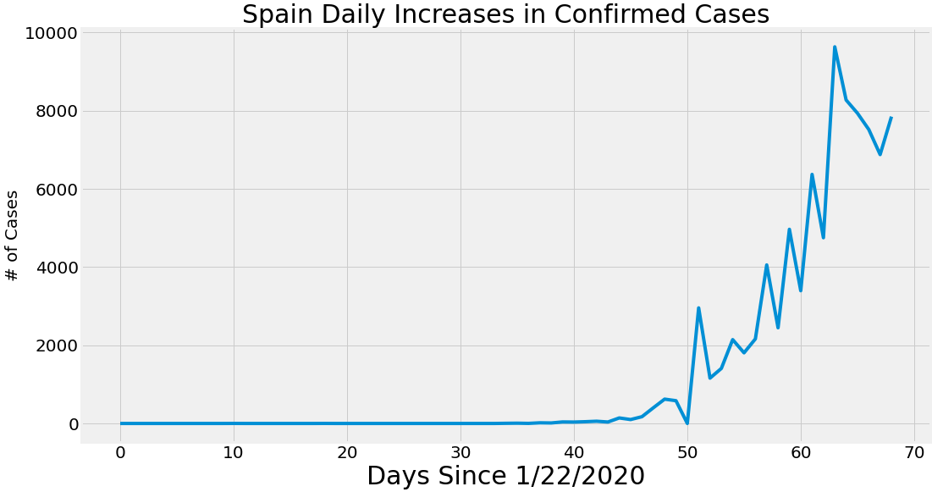
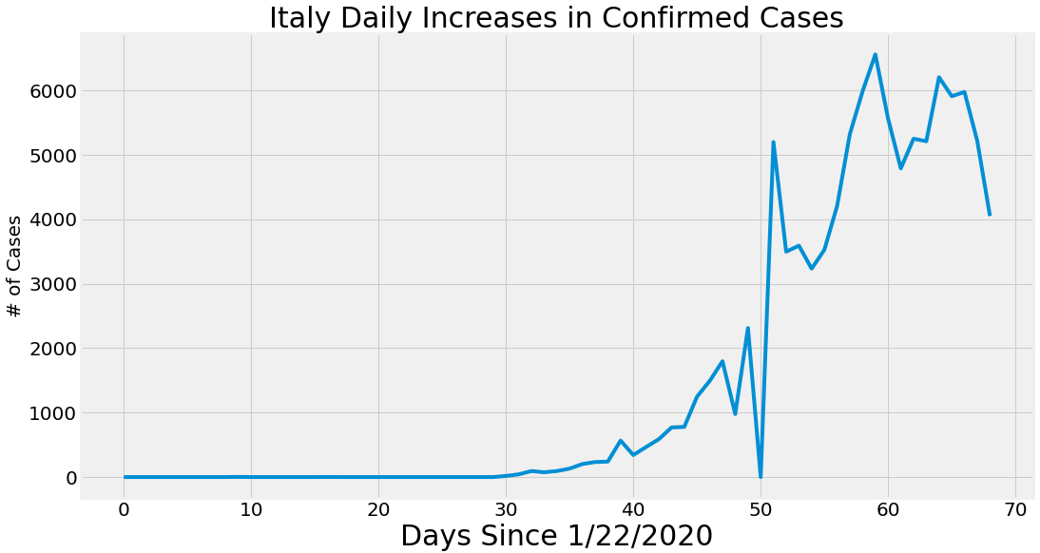
Trend Analysis
Observations:
South Korea shows steep decline in cases reported and US has highest cases since 22nd January
All countries seem to be following similar curves
As of Mar. 30

Slide 11
South Korea - success factors
Response time
Almost immediate response to virus
First case reported on January 20 and travel restrictions began on January 21 (beginning with Wuhan).
Testing regime
Testing began as soon as possible
Drive-thru testing
Joint effort between public and private sectors
Transparency
Real-time information shared with public
History of pandemics
Avian Flu: Mid - 2010s
SARS: Early 2000s
Data sources (link in Notes):
Center for Strategic & International Studies, A Timeline of South Korea’s Response to COVID-19
John Hopkins, Coronavirus Dashboard
Notes:
Source links:
https://www.csis.org/analysis/timeline-south-koreas-response-covid-19
https://gisanddata.maps.arcgis.com/apps/opsdashboard/index.html#/bda7594740fd40299423467b48e9ecf6

Slide 12
Demographics

Slide 13
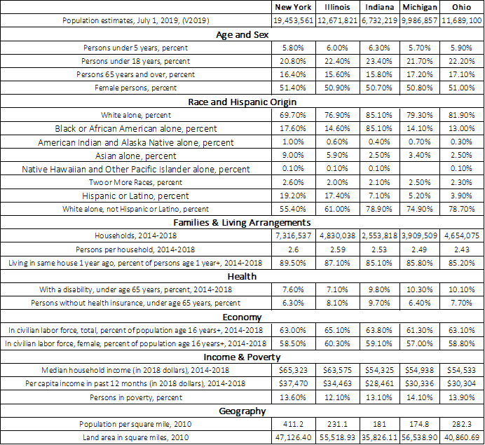
Demographics - State Overview
Observations:
Michigan and Ohio have a large >65 and disabled population (>17% and >10%, respectively).
Michigan and Ohio have a poverty rate of approx. 14%.
COVID-19 Fact:
According to the CDC, adults with pre-existing health conditions and/or are over the age of 65 are at “higher risk for severe [COVID-19] illness”.
Notes:
Source link: https://www.cdc.gov/coronavirus/2019-ncov/need-extra-precautions/older-adults.html?CDC_AA_refVal=https%3A%2F%2Fwww.cdc.gov%2Fcoronavirus%2F2019-ncov%2Fspecific-groups%2Fhigh-risk-complications%2Folder-adults.html

Slide 14
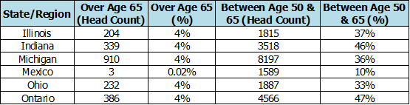
Demographics - by State/Region
Observations:
4% of the workforce in all states/regions, except Mexico, is over the age of 65.
At least 33% population of all states/regions, except Mexico, is between the ages of 50 and 65.
Indiana and Ontario have the largest population of ages between of 50 and 65 (46% and 47%, respectively).
COVID-19 Facts:
According to the CDC, adults with pre-existing health conditions and/or over the age of 65 are at “higher risk for severe [COVID-19] illness”.
The CDC reports that 20.5% of adults ages 55 to 64 with COVID-19 are hospitalized and 1.4% die. Of adults between 65 and 74, 28.6% are hospitalized and 2.7% die.
According to the Kaiser Family Foundation, ~½ of Americans ages 55 to 64 have a pre-existing health condition.
Notes:
Breakdown by plant can be found in the backup
Source links:
https://www.cdc.gov/coronavirus/2019-ncov/need-extra-precautions/older-adults.html?CDC_AA_refVal=https%3A%2F%2Fwww.cdc.gov%2Fcoronavirus%2F2019-ncov%2Fspecific-groups%2Fhigh-risk-complications%2Folder-adults.html
https://www.vox.com/2020/3/23/21190033/coronavirus-covid-19-deaths-by-age

Slide 15
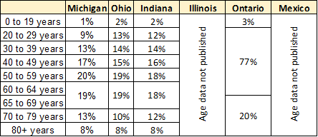
Demographics - COVID-19 Patients
Observations:
In Michigan, Ohio, and Indiana, more than 50% of COVID-19 patients are ages of 50 and greater.
In Michigan, Ohio, and Indiana, the age groups with the largest number of COVID-19 patients are 50 - 59 years and 60 to 69 years.
33% of population is between the ages of 50 and 65 and 4% is over the age of 65.
As of Mar. 30
Data sources (links in Notes):
Michigan: Michigan.gov, Coronavirus
Ohio: Ohio.gov, Coronavirus Dashboard
Indiana: In.gov, Coronavirus
Ontario: Ontario.ca, Status of cases in Ontario
Notes:
Source Links:
Michigan: https://www.michigan.gov/coronavirus/0,9753,7-406-98163-520743--,00.html
Ohio: https://coronavirus.ohio.gov/wps/portal/gov/covid-19/home/dashboard/overview/
Indiana: https://coronavirus.in.gov/?utm_source=agency-website&utm_medium=banner-image&utm_campaign=&utm_term=&utm_content=core
Ontario: https://www.ontario.ca/page/2019-novel-coronavirus#section-0

Slide 16
COVID-19 Current State

Slide 17
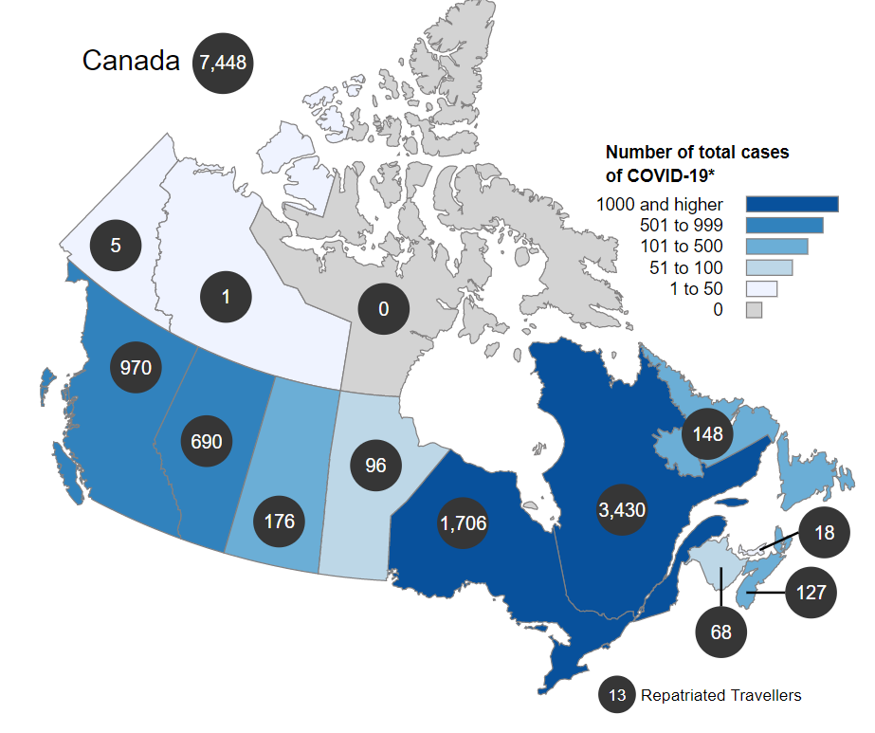
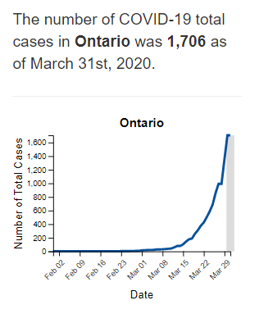
COVID-19 Current State - CANADA
Observations:
Ontario is second highest in Canada
Lower than 19th highest US state
As of Mar. 31
Data source (link in Notes):
Canada.ca, Coronavirus disease (COVID-19): Outbreak update
Notes:
Source Links:
https://www.canada.ca/en/public-health/services/diseases/2019-novel-coronavirus-infection.html#a1

Slide 18
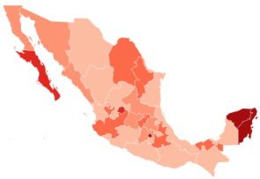
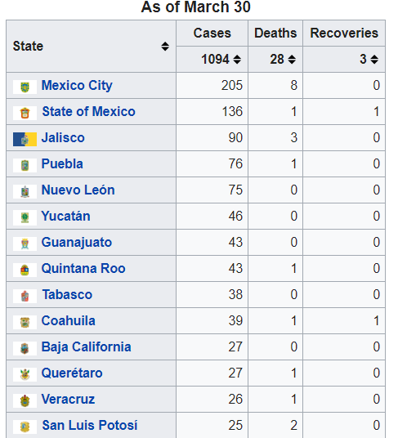
COVID-19 Current State - Mexico
Toluca
Observations:
Identified cases lower than all other states and provinces
Saltillo
Data sources (links in Notes):
Secretariat of Health
Geological and Atmospheric Research Institute
National Institute of Statistics and Geography
As of Mar. 30
Notes:
Source Links:
https://en.wikipedia.org/wiki/2020_coronavirus_pandemic_in_Mexico
https://www.gob.mx/salud/es/archivo/prensa?idiom=es&order=DESC&page=1
http://iigea.com/amag/covid-19/
http://www.cuentame.inegi.org.mx/poblacion/habitantes.aspx?tema=P

Slide 19
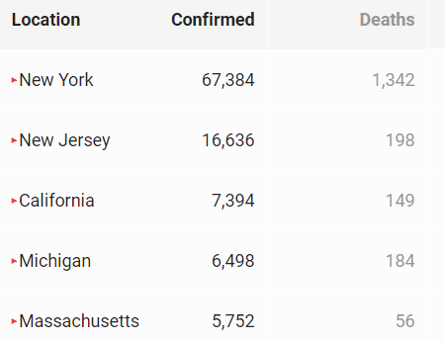
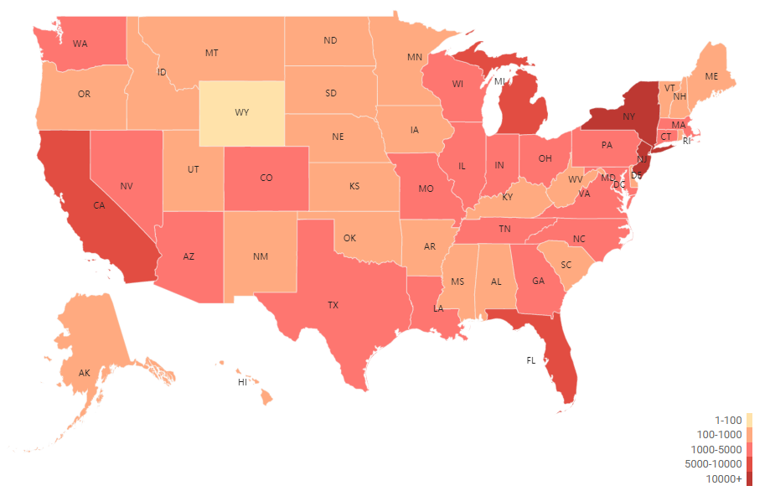
COVID-19 Current State - USA
Observations:
Michigan is the 4th highest state in cases
Data source (link in Notes):
Newsbreak, Coronavirus Realtime Updates - data aggregated from gov. websites and released records such as CDC and WHO
As of Mar. 31
Link
Notes:
Source Links:
https://www.newsbreak.com/topics/coronavirus?s=web

Slide 20
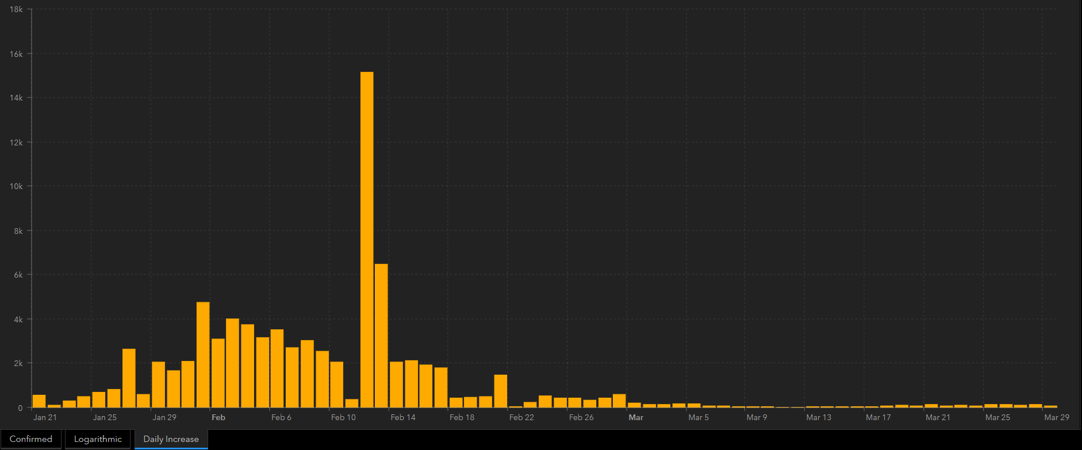
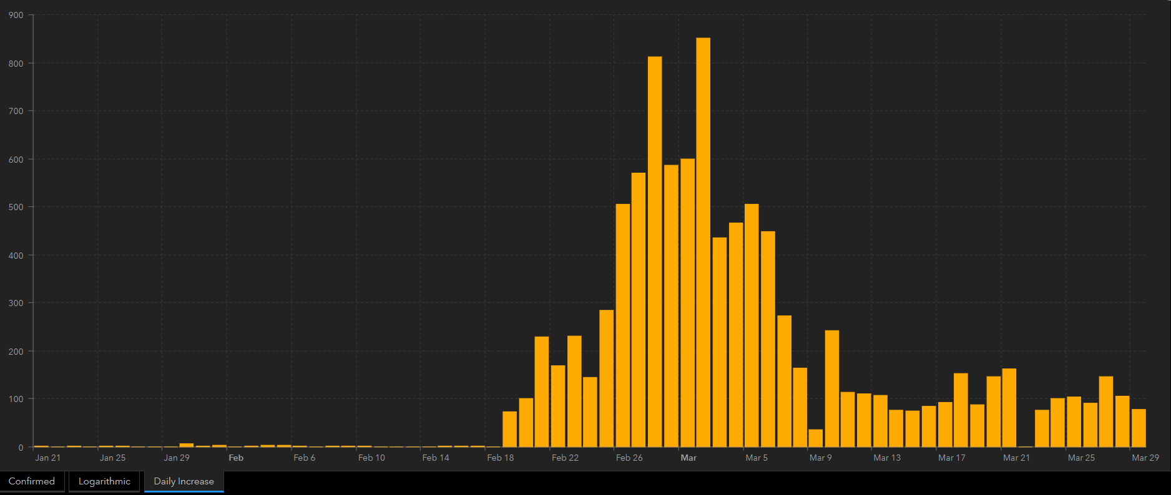
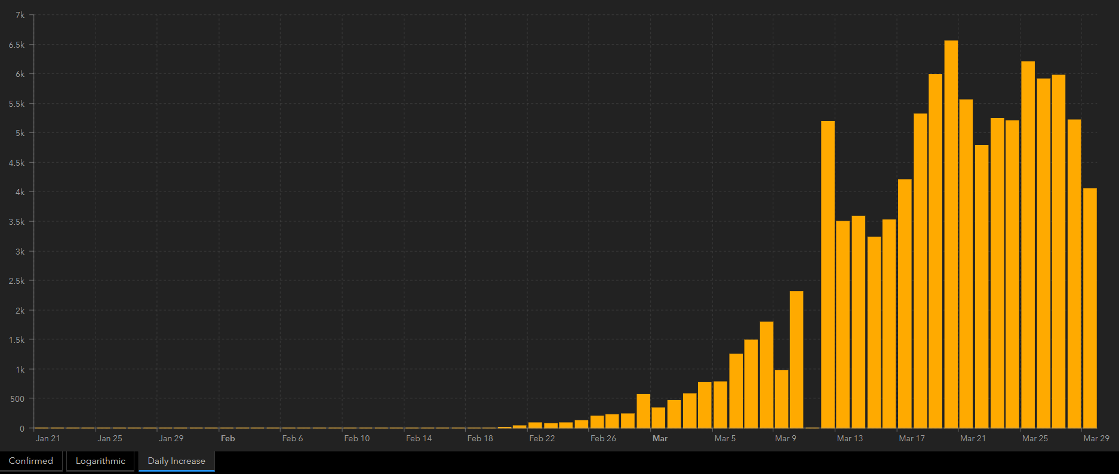
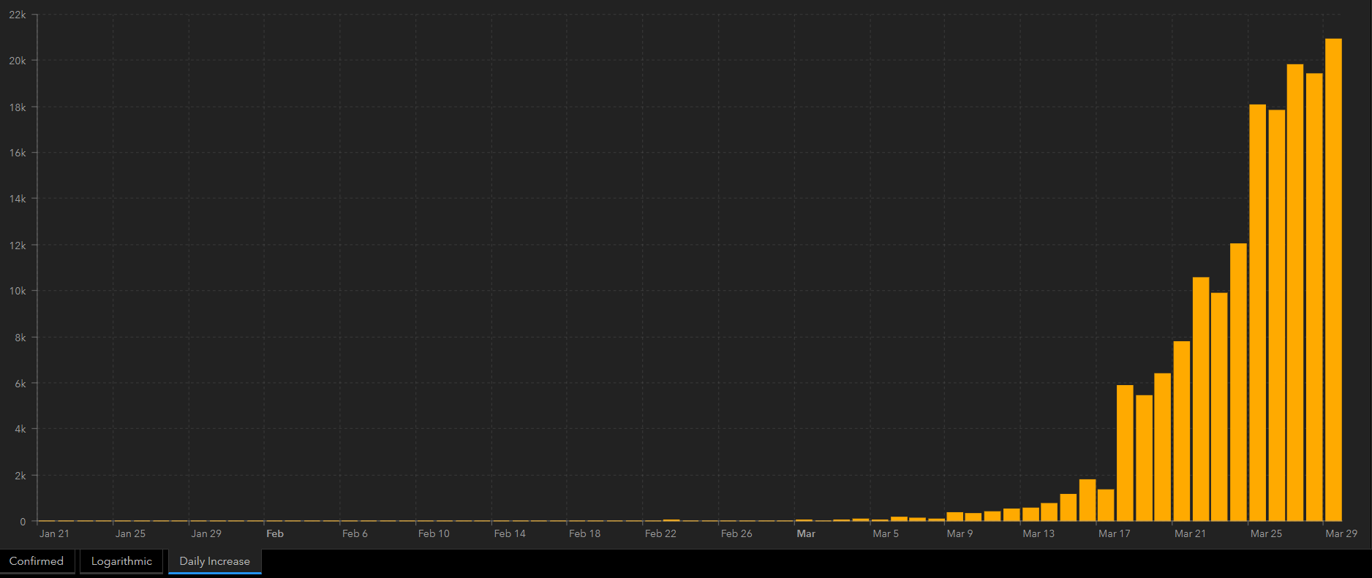
COVID 19 Curve Comparisons
Hubei
Observations:
Comparison of curves meant to show timing and progression of cases - not magnitude
China had an anomalous spike
S. Korea is on the end of the curve
Italy may be past peak
US still on the increase
S. Korea
As of Mar. 31
Italy
USA
New confirmed COVID-19 cases by day. Source: John Hopkins Coronavirus Dashboard.
Notes:
Source link:
https://gisanddata.maps.arcgis.com/apps/opsdashboard/index.html#/bda7594740fd40299423467b48e9ecf6

Slide 21
Timeline Summary
State | Date 1st Case Reported | IHME Expected Death Peak Date Range | IHME Expected Zero Deaths Achieved Date
USA | 1/21 | 4/14 - 4/19 | 7/16
New York | 3/1 | 4/10 - 4/12 | 5/11
Michigan | 3/10 | 4/10 - 4/12 | 5/6
Ohio | 3/1 | 4/21 - 4/25 | 5/27
Indiana | 3/6 | 4/18 - 4/23 | 5/26
Illinois | 1/24 | 4/17 - 4/21 | 5/22

Slide 22
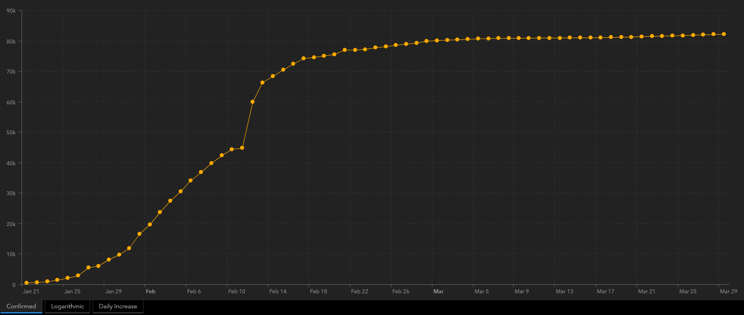
Hubei Timeline
As of Mar. 31
Timeline:
Dec. 31, 2019: Wuhan government confirms the treatment of dozens of pneumonia cases of “unknown cause”.
Jan. 11, 2020: First COVID-19 death in China.
Jan. 23: Wuhan “shut down” begins → Transportation to, from, and within city is cancelled.
Feb. 13: Non-essential businesses (including manufacturing) shut down.
Feb. 20: All schools in Hubei province shut down.
Feb. 23: 14,000 new cases in Hubei Province → the peak.
Mar. 1: COVID-19 cases begin to flatten in China.
Mar. 19: China reports no new local infections.
Experts state a minimum of 14 consecutive days without new infections is needed to determine if outbreak is over.
Mar. 22: Wuhan begins the process of lifting restrictions.
Apr. 8: Target date for all restrictions to be removed.
New confirmed COVID-19 cases by day in China. Source: John Hopkins Coronavirus Dashboard.
NOTE: Questions are being raise around the reliability of China’s data.
Total confirmed COVID-19 cases by day in China. Source: John Hopkins Coronavirus Dashboard.
Data sources (links in Notes):
New York Times, A Timeline of the Coronavirus Pandemic
Various sources, 2020 Hubei lockdowns
Notes:
Timeline Sources:
https://www.nytimes.com/article/coronavirus-timeline.html
https://en.wikipedia.org/wiki/2020_Hubei_lockdowns
Graph source:
https://gisanddata.maps.arcgis.com/apps/opsdashboard/index.html#/bda7594740fd40299423467b48e9ecf6

Slide 23
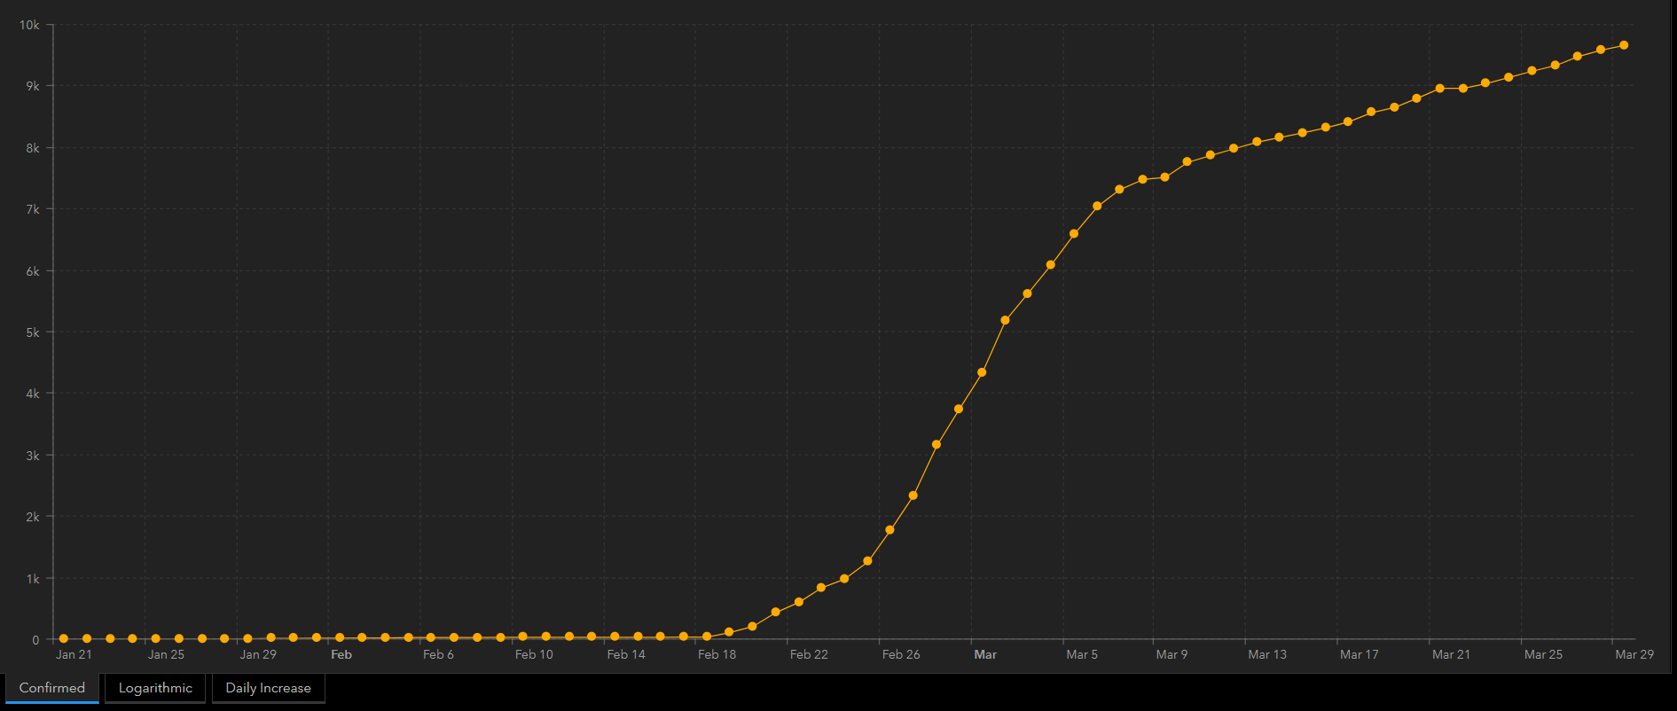
South Korea Timeline
As of Mar. 31
Timeline:
Jan. 20, 2020: First COVID-19 cases reported.
Jan. 22: First COVID-19 death reported.
Jan. 28: All persons entering South Korea are fully inspected upon entering.
Feb. 7: Test kits are available at 50 health care facilities.
Feb. 13: Test kit supply is increased.
Feb. 18: “Patient 31” confirmed in Daegu, the country’s 3rd largest city pushing shutdown→ critical point in the rapid transmission of COVID-19 in South Korea
Feb. 23: First drive-thru testing checkpoint opens.
Mar. 2: Peak number of cases at 851 new cases. Social distancing is advised until early March.
Mar. 10: Start of school year is postponed until March 23 (later moved to April 6).
Mar. 28: Number of recovered COVID-19 patients exceeds the number of quarantined COVID-19 patients.
New confirmed COVID-19 cases by day in South Korea. Source: John Hopkins Coronavirus Dashboard.
Total confirmed COVID-19 cases by day in South Korea. Source: John Hopkins Coronavirus Dashboard.
Data sources (link in Notes):
Center for Strategic & International Studies, A Timeline of South Korea’s Response to COVID-19
John Hopkins, Coronavirus Dashboard
Notes:
Timeline Sources:
https://www.csis.org/analysis/timeline-south-koreas-response-covid-19
https://gisanddata.maps.arcgis.com/apps/opsdashboard/index.html#/bda7594740fd40299423467b48e9ecf6
Graph source:
https://gisanddata.maps.arcgis.com/apps/opsdashboard/index.html#/bda7594740fd40299423467b48e9ecf6

Slide 24
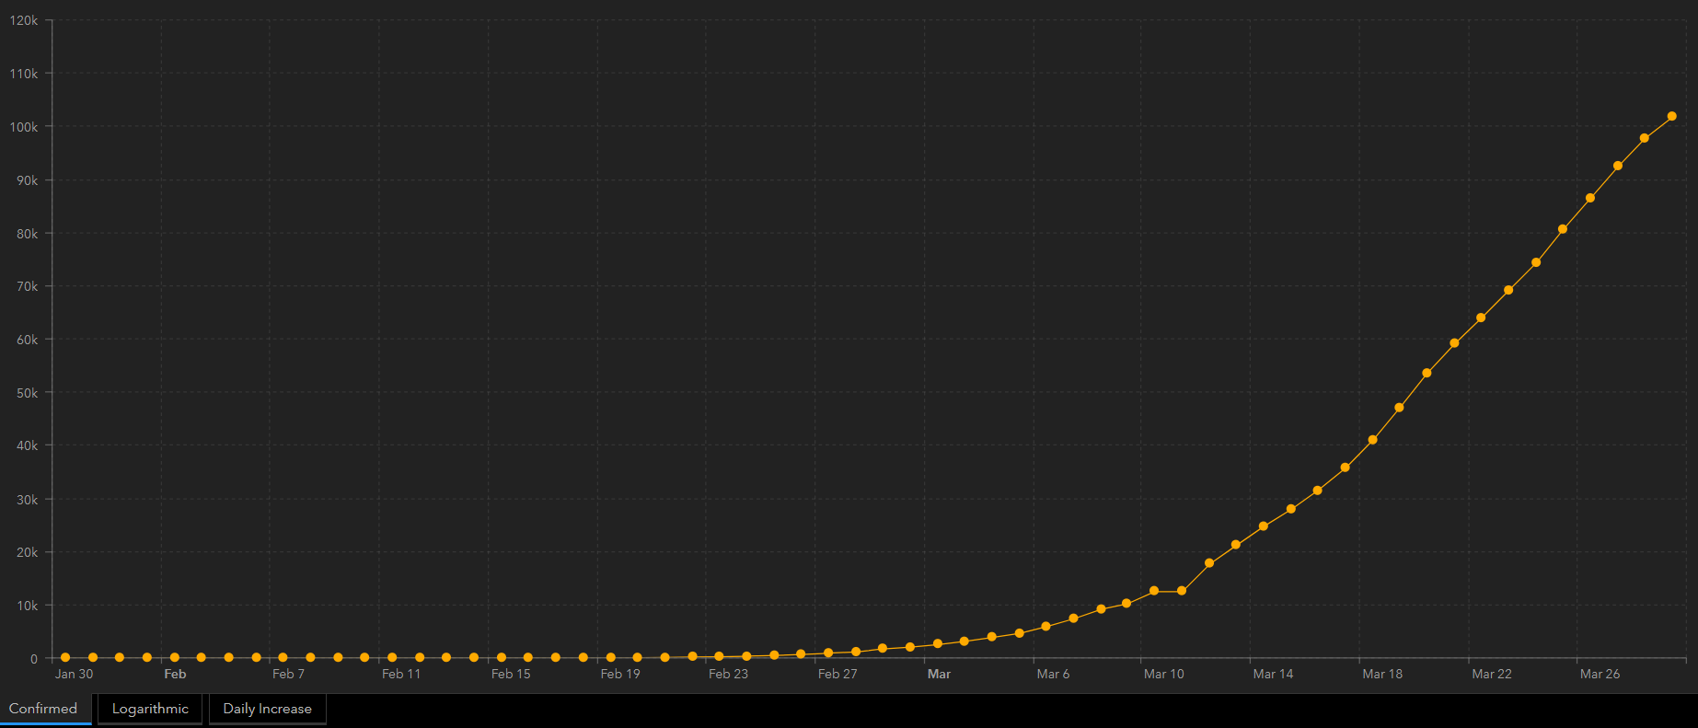
Italy Timeline
As of Mar. 31
Timeline:
Jan. 31, 2020: Italy suspends flights to China and declares a national emergency after two cases are confirmed in Rome (2 confirmed cases).
Feb. 15: First COVID-19 case reported.
Feb. 23: Small towns hit by the outbreak are placed under quarantine. Carnival celebrations and some soccer matches are canceled (150 cases).
Mar. 4: Schools and universities are closed (3,089 cases).
Mar. 8: Several northern provinces are placed under lockdown (7,375 cases).
Mar. 9: The lockdown is extended nationwide (9,172 cases).
Mar. 11: All restaurants and bars are closed (12,462 cases).
Mar. 22: Factories are closed and all nonessential production is halted (59,138 cases).
New confirmed COVID-19 cases by day in Italy. Source: John Hopkins Coronavirus Dashboard.
Data sources (links in Notes):
Axios, Timeline: How Italy’s coronavirus crisis became the world’s deadliest
Wired, How Italy became the ground zero of Europe’s coronavirus crisis
John Hopkins, Coronavirus Dashboard
Total confirmed COVID-19 cases by day in Italy. Source: John Hopkins Coronavirus Dashboard.
Notes:
Timeline Sources:
https://www.axios.com/italy-coronavirus-timeline-lockdown-deaths-cases-2adb0fc7-6ab5-4b7c-9a55-bc6897494dc6.html
https://www.wired.co.uk/article/coronavirus-italy
https://gisanddata.maps.arcgis.com/apps/opsdashboard/index.html#/bda7594740fd40299423467b48e9ecf6
Graph source:
https://gisanddata.maps.arcgis.com/apps/opsdashboard/index.html#/bda7594740fd40299423467b48e9ecf6

Slide 25
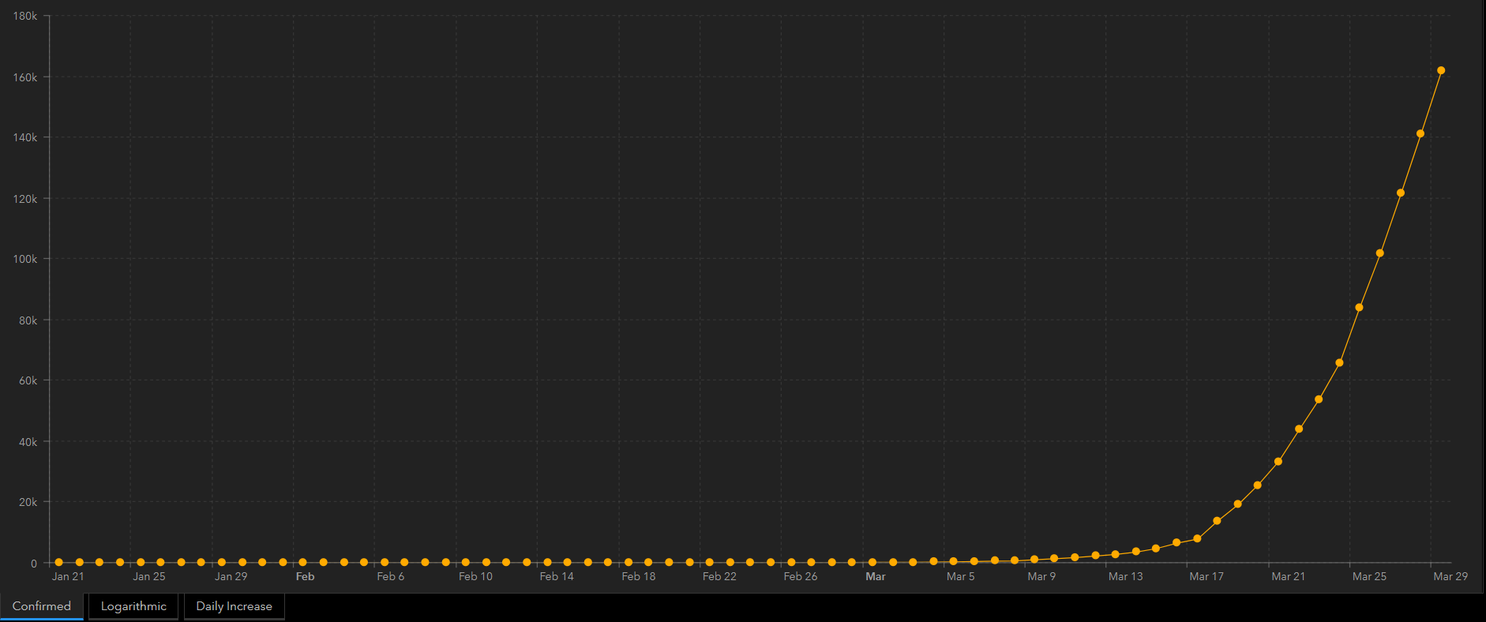
USA Timeline
As of Mar. 31
Timeline:
Jan. 21, 2020: First COVID-19 cases reported.
Jan. 31: USA restricts travel from China.
Feb. 29: First COVID-19 death.
Mar. 3: USA approves widespread coronavirus testing.
Mar. 11: Travel from Europe restricted.
Mar. 13: National emergency declared.
Mar. 15: Beginning of social distancing policies. 4.6k cases of COVID-19 confirmed in USA.
Mar. 29: Social distancing policies are extended to April 30th.
Apr. 14 - 19: IHME estimated peak death day range.
Jul. 16: COVID-19 related deaths predicted to be zero by IHME.
New confirmed COVID-19 cases by day in the United States. Source: John Hopkins Coronavirus Dashboard.
Data sources (links in Notes):
New York Times, A Timeline of the Coronavirus Pandemic
The Wall Street Journal, White House Extends Social-Distancing Guidelines until end of April
IHME, COVID-19 Predictions
Total confirmed COVID-19 cases by day in the United States. Source: John Hopkins Coronavirus Dashboard.
Notes:
Timeline Sources:
https://www.nytimes.com/article/coronavirus-timeline.html
https://www.wsj.com/articles/coronavirus-deaths-top-30-000-as-china-opens-up-province-where-it-began-11585466594
https://covid19.healthdata.org/projections - IHME model assumes social distancing thru May.
Graph source:
https://gisanddata.maps.arcgis.com/apps/opsdashboard/index.html#/bda7594740fd40299423467b48e9ecf6

Slide 26
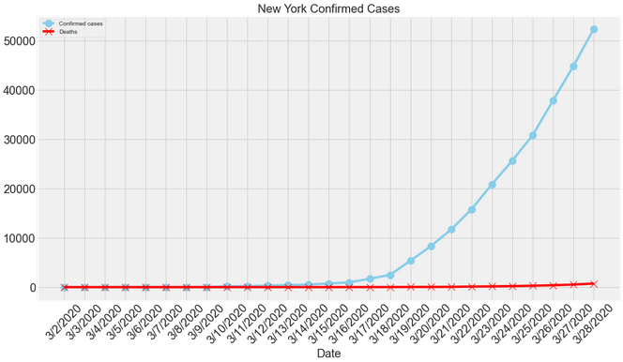
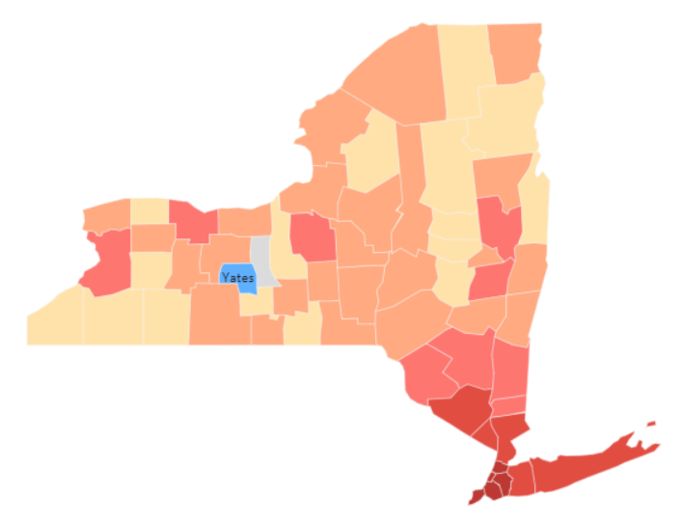
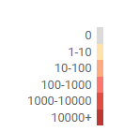
New York Timeline
As of Mar. 31
Timeline:
Mar. 1, 2020: First COVID-19 cases reported.
Mar. 7: State of emergency announced.
Mar. 10: Beginning of social distancing policies.
Mar. 10: Schools and large gathering places temporarily close.
Mar. 18 - 20: Most public places (bars, gyms, schools, etc.) are closed.
Mar. 14: First COVID-19 death.
Mar. 22 - Apr. 15: Statewide stay-at-home order for all non-essential workers.
Apr. 10 - 12: IHME estimated peak death day range.
May 11: COVID-19 related deaths predicted to be zero by IHME.
Data sources (links in Notes):
USA Today, Lohud, Coronavirus Timeline in New York
IHME, COVID-19 Predictions
Time, New York’s First Death from COVID-19
Newsbreak, Coronavirus Realtime Updates - data aggregated from gov. websites and released records such as CDC and WHO
Notes:
Timeline Sources:
https://www.lohud.com/story/news/politics/2020/03/13/coronavirus-timeline-new-york-how-we-got-here-and-where-were-headed/5045463002/
https://covid19.healthdata.org/projections - IHME model assumes social distancing thru May.
https://time.com/5803182/new-york-coronavirus-death/
Graph source:
https://www.newsbreak.com/topics/coronavirus?s=web

Slide 27
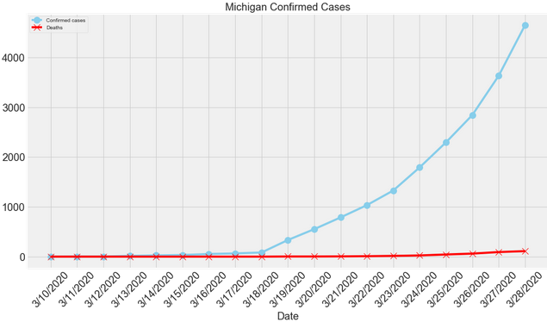
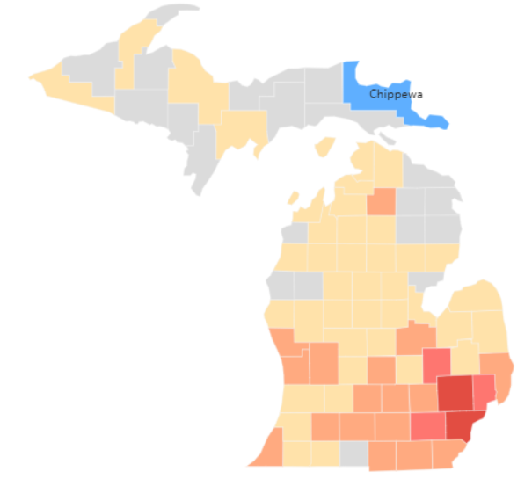
Michigan Timeline
As of Mar. 31
Timeline:
Mar. 10, 2020: First COVID-19 cases reported. Gov. Whitmer announces state of emergency.
Mar. 11: Gov. Whitmer urges social distancing.
Mar. 13: Beginning of social distancing policies.
Mar. 13: Schools close and gatherings over 250 people are banned.
Mar. 16: Most public places (bars, gyms, etc.) are closed.
Mar. 17: First COVID-19 death.
Mar. 23 - Apr. 13: Statewide stay-at-home order for all non-essential workers.
Apr. 10 - 12: IHME estimated peak death day range.
May 6: COVID-19 related deaths predicted to be zero by IHME.
NOTE: Detroit is predicted to one of the next USA hot spots. The population is considered to be “very high risk” due to pre-existing health conditions, lack of proper health care treatment, living situations, and other social issues.
Data sources (links in Notes):
Click-on Detroit, Michigan Coronavirus Timeline
IHME, COVID-19 Predictions
Detroit Free Press, ‘Southeast Michigan is burning’
Newsbreak, Coronavirus Realtime Updates - data aggregated from gov. websites and released records such as CDC and WHO
Notes:
Timeline Sources:
https://www.clickondetroit.com/health/2020/03/24/michigan-coronavirus-timeline-key-dates-covid-19-case-tracking-state-orders/
https://covid19.healthdata.org/projections - IHME model assumes social distancing thru May.
https://www.freep.com/in-depth/news/local/michigan/2020/03/28/michigan-coronavirus-surge-covid-19-case-count/2898574001/?fbclid=IwAR169-gXftTUE8moFa9MMddRgjESA1VQtn7KZX8c1nppTXVkVDscNvhLU48
Graph source:
https://www.newsbreak.com/topics/coronavirus?s=web

Slide 28
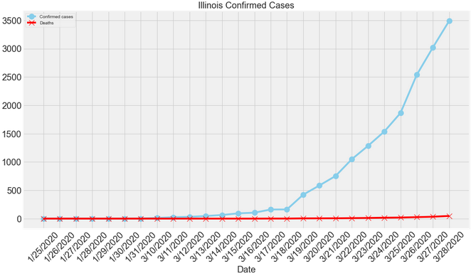
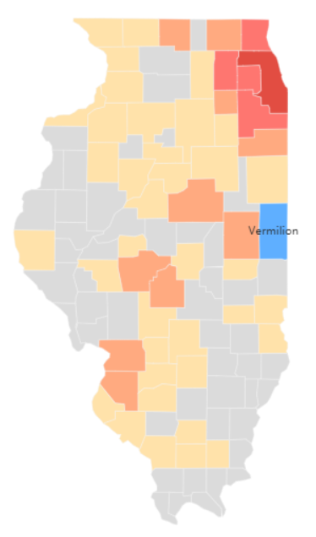
Illinois Timeline
As of Mar. 31
Timeline:
Jan. 24, 2020: First COVID-19 case reported.
Feb. 11: In-state testing begins.
Mar. 12: Social distancing policies begin.
Mar. 12: Gathering greater than 1,000 people are banned.
Mar. 15: Dine-in restaurants are closed.
Mar. 17: Schools closed.
Mar. 17: First COVID-19 death.
Mar. 21 - Apr. 7: Statewide stay-at-home order for all non-essential workers.
Apr. 17 - 21: IHME estimated peak death day range.
May 22: COVID-19 related deaths predicted to be zero by IHME.
NOTE: Chicago is predicted to one of the next USA hot spots.
Data sources (links in Notes):
ABC 7 Eyewitness News, Coronavirus Illinois Update
IHME, COVID-19 Predictions
Newsbreak, Coronavirus Realtime Updates - data aggregated from gov. websites and released records such as CDC and WHO
Notes:
Timeline Sources:
https://abc7chicago.com/coronavirus-chicago-illinois-update-cases-covid-19-news/5973196/
https://covid19.healthdata.org/projections - IHME model assumes social distancing thru May.
Graph source:
https://www.newsbreak.com/topics/coronavirus?s=web

Slide 29
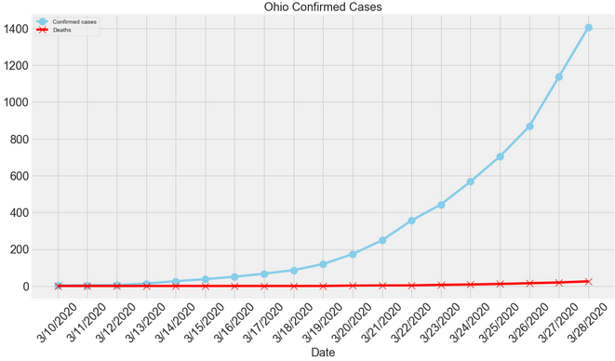
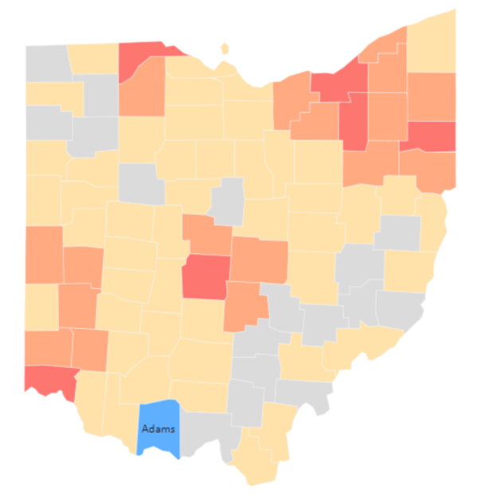
Ohio Timeline
As of Mar. 31
Timeline:
Mar. 1, 2020: First COVID-19 case reported. Gov. DeWine declares state of emergency.
Mar. 12: Beginning of social distancing policies.
Mar. 12: Schools closed and gatherings greater than 100 people banned.
Mar. 15 - 18: Most public places closed.
Mar. 20: First COVID-19 death.
Mar. 24 - Apr. 7: Statewide stay-at-home order for all non-essential workers.
Apr. 21 - 25: IHME estimated peak death day range.
May 27: COVID-19 related deaths predicted to be zero by IHME.
Data sources (links in Notes):
Dayton Daily News, Coronavirus Timeline
IHME, COVID-19 Predictions
Newsbreak, Coronavirus Realtime Updates - data aggregated from gov. websites and released records such as CDC and WHO
Notes:
Timeline Sources:
https://www.daytondailynews.com/news/local/timeline-coronavirus-prompts-orders-changing-everyday-life-ohio/gpnVSADPxZxMltlDVyqKEP/
https://covid19.healthdata.org/projections - IHME model assumes social distancing thru May.
Graph source:
https://www.newsbreak.com/topics/coronavirus?s=web

Slide 30
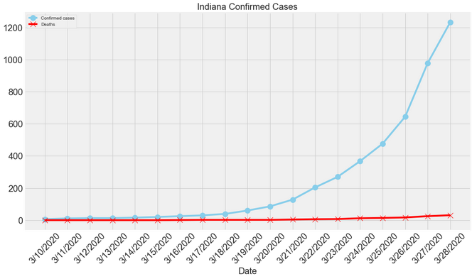
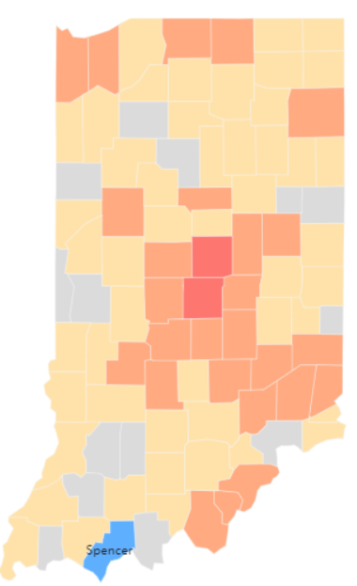
Indiana Timeline
As of Mar. 31
Timeline:
Mar. 6, 2020: First COVID-19 case reported.
Mar. 12: Beginning of social distancing policies.
Mar. 12: Schools closed and large events cancelled.
Mar. 16 - 19: Most public places closed, including schools.
Mar. 16: First COVID-19 death.
Mar. 24 - Apr. 7: Statewide stay-at-home order for all non-essential workers.
Apr. 18 - 23: IHME estimated peak death day range.
May 26: COVID-19 related deaths predicted to be zero by IHME.
Data sources (links in Notes):
WISH-TV and the News 8, COVID-19 updates
IHME, COVID-19 Predictions
Newsbreak, Coronavirus Realtime Updates - data aggregated from gov. websites and released records such as CDC and WHO
Notes:
Timeline Sources:
https://www.wishtv.com/news/medical/isdh-645-hoosiers-now-positive-for-covid-19-17-dead/
https://covid19.healthdata.org/projections - IHME model assumes social distancing thru May.
Graph source:
https://www.newsbreak.com/topics/coronavirus?s=web

Slide 31
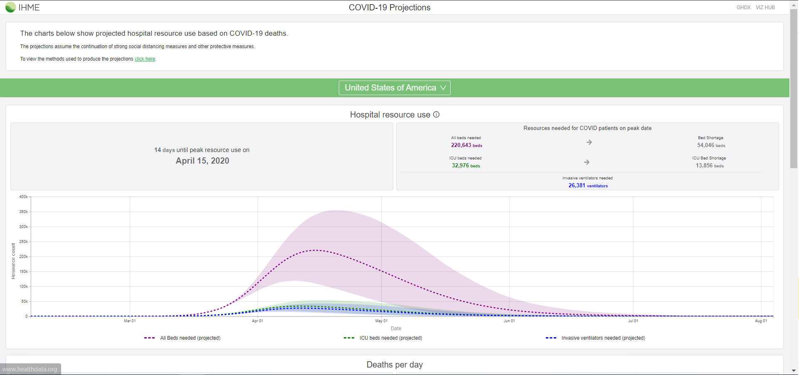
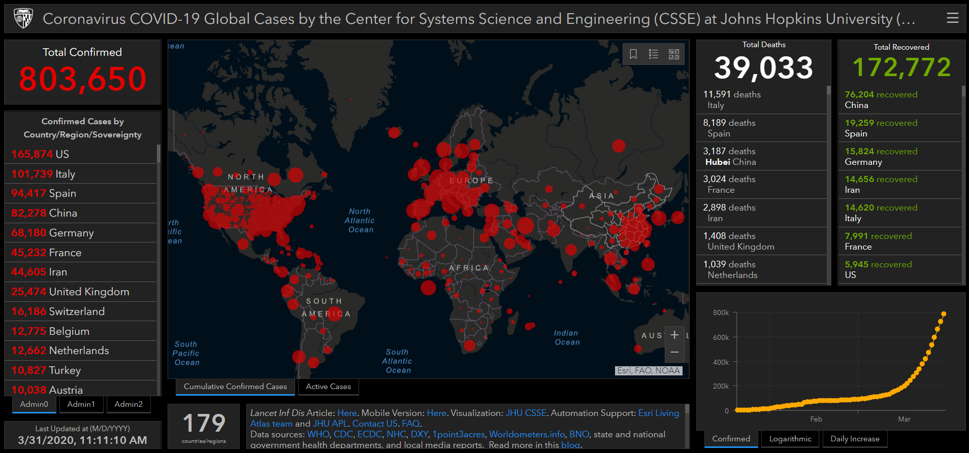
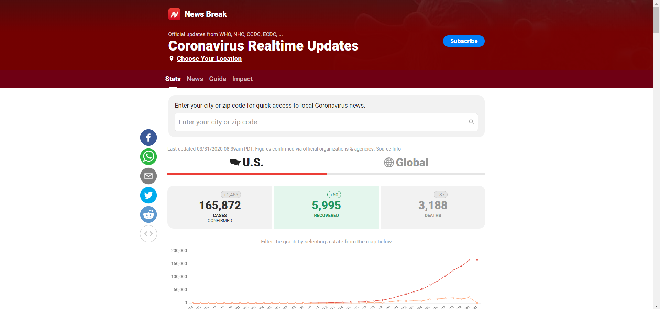
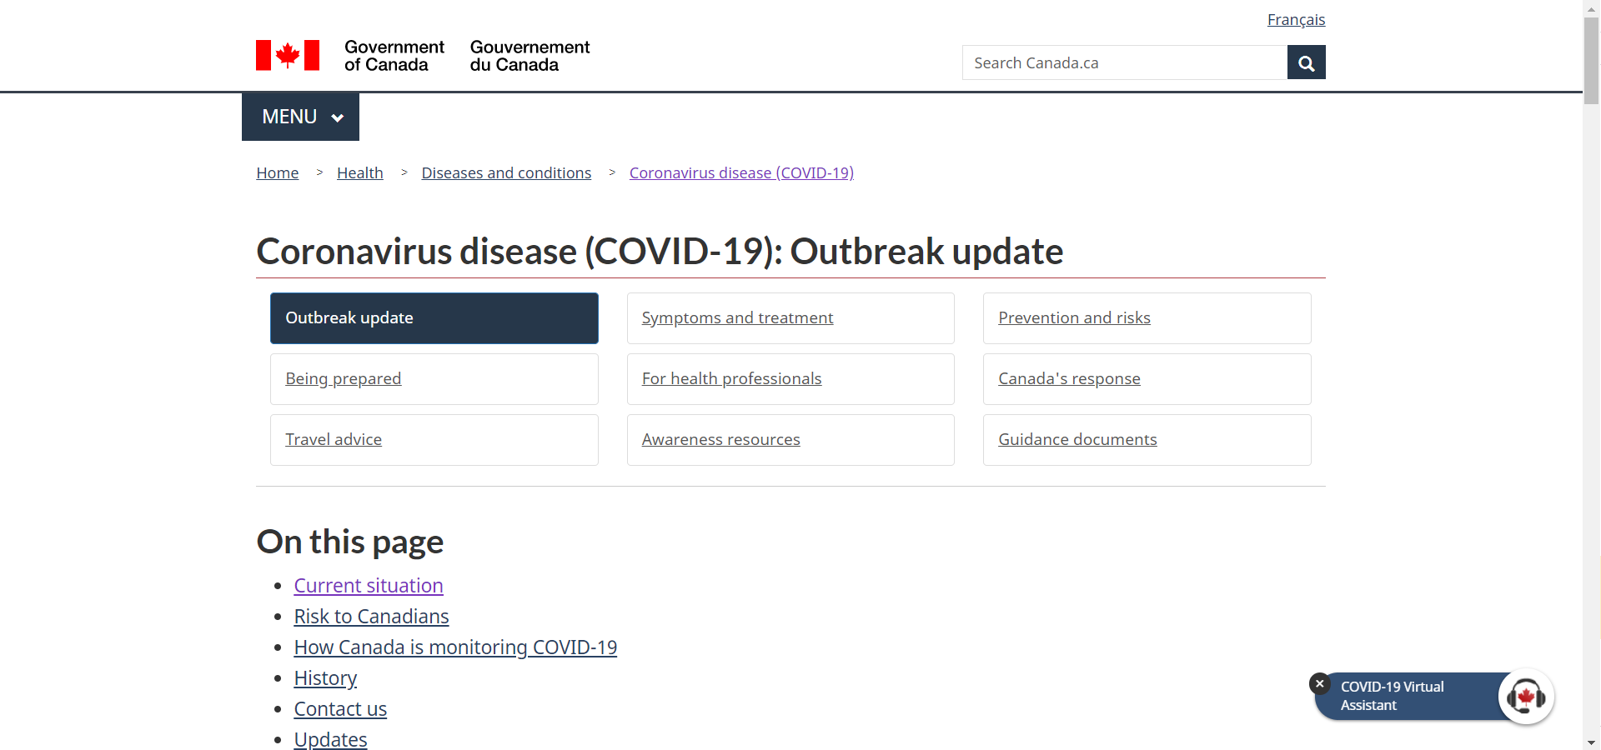
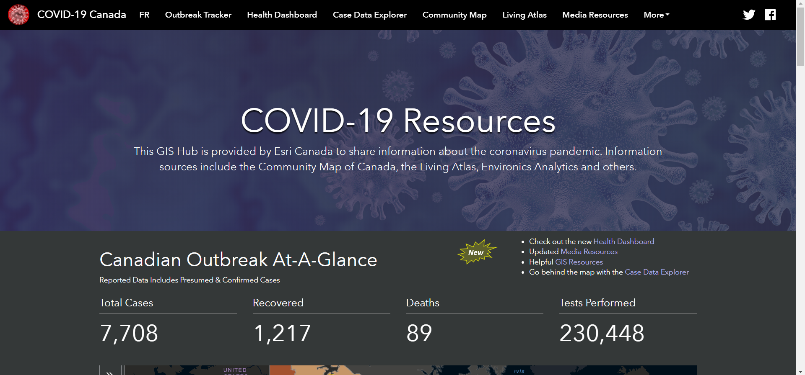
Links to Credible Dashboards
IHME: USA COVID-19 Projections
John Hopkins: Coronavirus Dashboard
News Break: USA Coronavirus Updates
Canada: Gov. COVID-19 Update
Esri Canada: COVID-19 Dashboard

Slide 32
Institute for Health Metrics and Evaluation (IHME)
The Institute for Health Metrics and Evaluation (IHME) is an independent population health research center at UW Medicine, part of the University of Washington
Design, Setting, and Participants: This study used data on confirmed COVID-19 deaths by day from WHO websites and local and national governments; data on hospital capacity and utilization for US states; and observed COVID-19 utilization data from select locations to develop a statistical model forecasting deaths and hospital utilization against capacity by state for the US over the next 4 months.
Notes:
Source Link:
https://covid19.healthdata.org/projections

Slide 33
COVID 19 Peak and Curve v. Recovery
As of Mar. 31
IHME forecast model
Critical States | Death Peak | Curve Flattens
USA | 4/14 | 6/15
NY | 4/10 | 5/1
MI | 4/11 | 5/1
OH | 4/19 | 5/20
IN | 4/17 | 5/18
IL | 4/16 | 5/18
WI | 4/25 | 6/1
CA | 4/25 | 6/15
WA | 4/24 | 6/15
Observations:
Death Rate is 1% of diagnosed, so it follows that active cases will reduce accordingly.
Recovery time is 7 days after symptoms end and 72 hours past fever. (Johns Hopkins*).
This could push out recovery 7-10 days after the curve. (**if added to the date the curve flattens)
Data source (link in Notes):
John Hopkins Medicine, I’ve been diagnosed with the new coronavirus disease
IHME, COVID-19 Predictions
*Lisa Maragakis, senior director of infection prevention at Johns Hopkins Medicine
Notes:
Source Links:
https://www.hopkinsmedicine.org/health/conditions-and-diseases/coronavirus/diagnosed-with-covid-19-what-to-expect

Slide 34
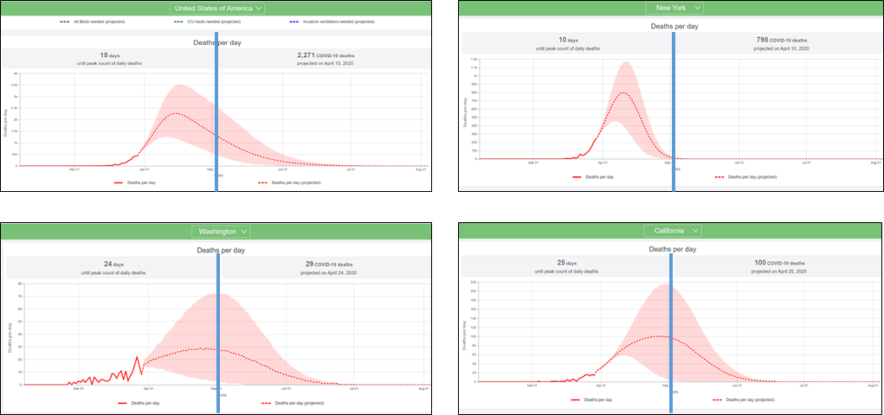
COVID 19 Curve and Peak (US and Hot Spots*)
As of Mar. 31
USA
NY
IHME forecast model
Critical States | Death Peak
USA | 4/14
NY | 4/10
MI | 4/11
OH | 4/20
IN | 4/17
IL | 4/16
WI | 4/25
CA | 4/25
WA | 4/24
Wash
Cali
Observations:
IHME model assumes social distancing thru May.
NY is considered the “lead curve”.
Washington and California have flatter and longer curves than Michigan and New York.
Data sources (link in Notes):
Institute for Health Metrics and Evaluation, University of Washington, COVID-19 Predictions
https://covid19.healthdata.org/projections
Notes:
Source Link:
https://covid19.healthdata.org/projections

